Slide 1

HoneycombOnArm64MacOS
User Guide
Honeycomb Bravo configuration plugin
Native Apple Silicon
For X-Plane 12
OpenSource
Run X-Plane 12 Apple Silicon compatible aircraft with Honeycomb Bravo controls, without needing Rosetta
© Dr Steve Proctor 2024
swp336@gmail.com
User Guide vBeta1.02

Slide 2
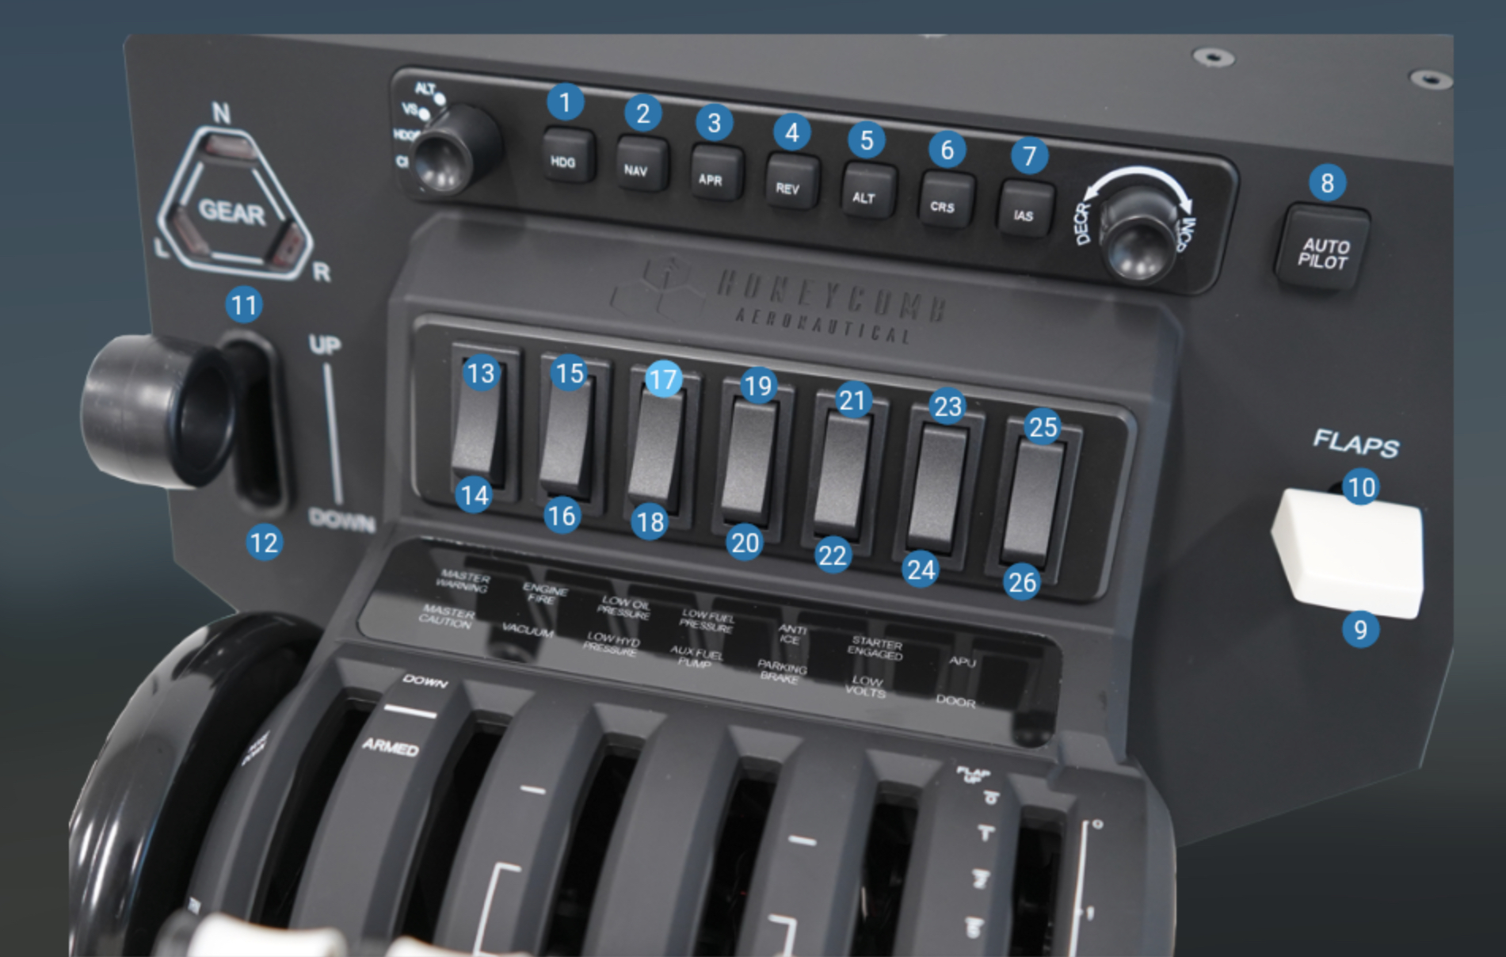
HoneycombOnArm64MacOS
Features
Assign commands for all rotary controls
Assign commands for all autopilot buttons
Assign datarefs for all annunciator lights
Assign datarefs for all autopilot button lights
Use Bravo switches to modify rotary and button behaviour
Built-in configs for all Laminar Research supplied aircraft
Uses JSON files to read/modify/create configs
© Dr Steve Proctor 2024
swp336@gmail.com
User Guide vBeta1.02

Slide 3
Creating JSON configuration files
Ensure the plugin is installed and configured as shown in the installation guide
Ensure this aircraft has been configured to use the plugin as shown in the installation guide.
Each time a new flight is started the plugin checks for a json configuration file for that specific aircraft
If the json file exists the plugin reads the X-Plane commands and datarefs then
assigns them to the bravo controls
If no json file exists the plugin creates a default configuration and writes this to
a new json file for that aircraft
Default configurations are built-in for all Laminar Research supplied aircraft
and for some 3rd party aircraft (currently only Zibo 737, more may be added in future)
HoneycombOnArm64MacOS
© Dr Steve Proctor 2024
swp336@gmail.com
User Guide vBeta1.02

Slide 4
Using the rotary controls – basic configuration
The left-hand rotary selects between ALT, VS, HDG, CRS, IAS
The right-hand rotary increments or decrements the chosen parameter
The json file configures a particular command to each of the five left-hand options
For example, the ALT selection may increase or decrease the Altitude setting
The VS selection may increase or decrease the vertical speed rate etc.
The specific commands to achieve this within X-Plane can vary between aircraft and
these are the commands held in the json file
HoneycombOnArm64MacOS
© Dr Steve Proctor 2024
swp336@gmail.com
User Guide vBeta1.02

Slide 5
Using the rotary controls – advanced configuration
Within a single aircraft, more than one feature can be assigned to each rotary selection
For example, the ALT selection might also be used to adjust the QNH, or the CRS feature might be used to separately adjust the pilot CRS setting and the co-pilot CRS setting
The bravo switches are used to select between these different options
In effect, multiple profiles can be created for each rotary option, with each bravo
rocker switch (see next slide) selecting a different profile of commands to be applied
Setting or unsetting the different rocker switches during flight (referred to within
the plug-in as Toggles) dynamically modifies the flight control adjusted by the
Increment/decrement rotary control for the ALT, VS, HDG, CRS or IAS selection
This enables a significant number of flight controls to be managed directly from the
Bravo device
HoneycombOnArm64MacOS
© Dr Steve Proctor 2024
swp336@gmail.com
User Guide vBeta1.02

Slide 6
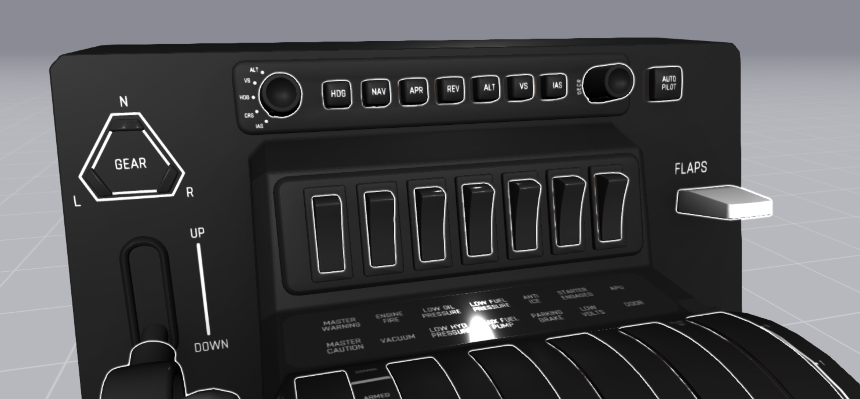
HoneycombOnArm64MacOS
Off
5
6
7
2
3
4
Toggle
switches
1
On
© Dr Steve Proctor 2024
swp336@gmail.com
User Guide vBeta1.02

Slide 7
Using the rotary controls – advanced example
The plug-in uses the 7 bravo switches as on/off toggles, numbered 1-7 from left to right (see previous page for details)
The table below shows an example configuration (a subset of the default Cessna Skyhawk config)
When all 7 toggles are in the ‘off’ position, the incr/decr rotary control will affect the flight controls in the
‘none active’ row (aka default command), depending on the feature selected by the left-hand rotary
If toggle 6 is Active (i.e., in the on position) then obs1 will be adjusted when HDG is selected. Alt, VS CRS and IAS are
unaffected by toggle 6 being active as they do not have any parameter defined for this combination, so they continue to
be Barometer, vertical speed etc. Similarly, if toggle 5 is active, the HDG option will adjust obs2.
The toggles are read from left to right, so if multiple toggles are active, the lowest numbered toggle is used
Where possible the default configurations try to align with cockpit workflows. For example, using the Toggle 6 profile to complete
one phase of flight setup, then moving to Toggle 5 for the next setup phase and so-on. The default commands (no active toggles) are generally the ones most frequently used in flight.
HoneycombOnArm64MacOS
Active Toggle | ALT | VS | HDG | CRS | IAS
None active | Barometer up/down | Vertical speed up/down | Heading bug up/down | obs_1 Up/down | -
Toggle 7 | Explained later | Explained later | Explained later | Explained later | Explained later
Toggle 6 | - | - | obs_1 Up/down | - | -
Toggle 5 | - | - | Co-pilot obs2 Up/down | - | -
Toggle 4 | - | - | adf1_card Up/down | - | -
© Dr Steve Proctor 2024
swp336@gmail.com
User Guide vBeta1.02

Slide 8
Using the rotary controls – moving quickly or precisely
Toggle 7 (directly under the incr/decr rotary) is reserved for controlling rotary resolution
Some flight controls such as altitude and heading can require large changes in value, but also need
to adjust to a precise value.
Toggle 7 controls whether the incr/decr rotary jumps quickly through the scale,
missing out intermediate values for rapid movement, or whether it moves through
every single value to ensure a precise setting. This enables for example, changing the
altitude setting from 10,000 to 30,000 feet to skip quickly to approximately 30,000 then
slow down to precisely select the required value. This usage quickly becomes intuitive.
Where a parameter doesn’t require rapid movement, for example setting vertical speed,
this feature is disabled and the rotary is always set for precision.
In principle, when not required, toggle 7 could (and can) be configured with any other
command. However, this could lead to confusion and the default configs all assume
toggle 7 is reserved.
HoneycombOnArm64MacOS
© Dr Steve Proctor 2024
swp336@gmail.com
User Guide vBeta1.02

Slide 9
Using the autopilot buttons – basic configuration
The 8 autopilot buttons* (HDG, NAV, APR, REV, ALT, VS, IAS, AP) can all be configured to trigger specific commands
Similar to the rotary controls, these command assignments are held within the json file for
that aircraft
Default configurations are built-in to the plug-in for all Laminar Research Aircraft
The table below shows an example configuration (a subset of the default
Laminar 737 config)
HoneycombOnArm64MacOS
Toggle | HDG | NAV | APR | REV | ALT | VS | IAS | AP
None | Heading select press | LNAV press | VORLOC press | - | ALT HLD Press | VS Press | SPEED Press | CMD A press
© Dr Steve Proctor 2024
swp336@gmail.com
*These are the labels on my bravo control, I have seen images suggesting other variants exist
User Guide vBeta1.02

Slide 10
Using the autopilot buttons – advanced configuration
Similar to the rotary controls, more than one command can be assigned to each autopilot button,
with the bravo toggles used to select between the different profiles
For the autopilot buttons, the toggles are read from right to left, so if multiple toggles are active, the highest numbered toggle is used.
This is opposite to the way rotary controls scan the toggles and allows for button settings and rotary settings
to be active simultaneously and independently, e.g., Toggle 1 and Toggle 6 both active, 1 changing
button behaviour and 6 changing rotary behaviour (see later topic on aligned configurations)
The table below shows an example button configuration (the full default Laminar 737 config)
HoneycombOnArm64MacOS
Toggle | HDG | NAV | APR | REV | ALT | VS | IAS | AP
None | Heading select | LNAV | VORLOC press | - | ALT HLD | VS | SPEED | CMD A
Toggle 4 |  |  |  |  | FO RST
Toggle 3 |  |  |  |  | FO STD |  |  | CWS B
Toggle 2 | EFIS Captain TFC |  |  |  | Captain RST |  |  | CWS A
Toggle 1 | EFIS Captain CTR | VNAV | APP |  | Captain STD | Level Change |  | CMD B
© Dr Steve Proctor 2024
swp336@gmail.com
User Guide vBeta1.02

Slide 11
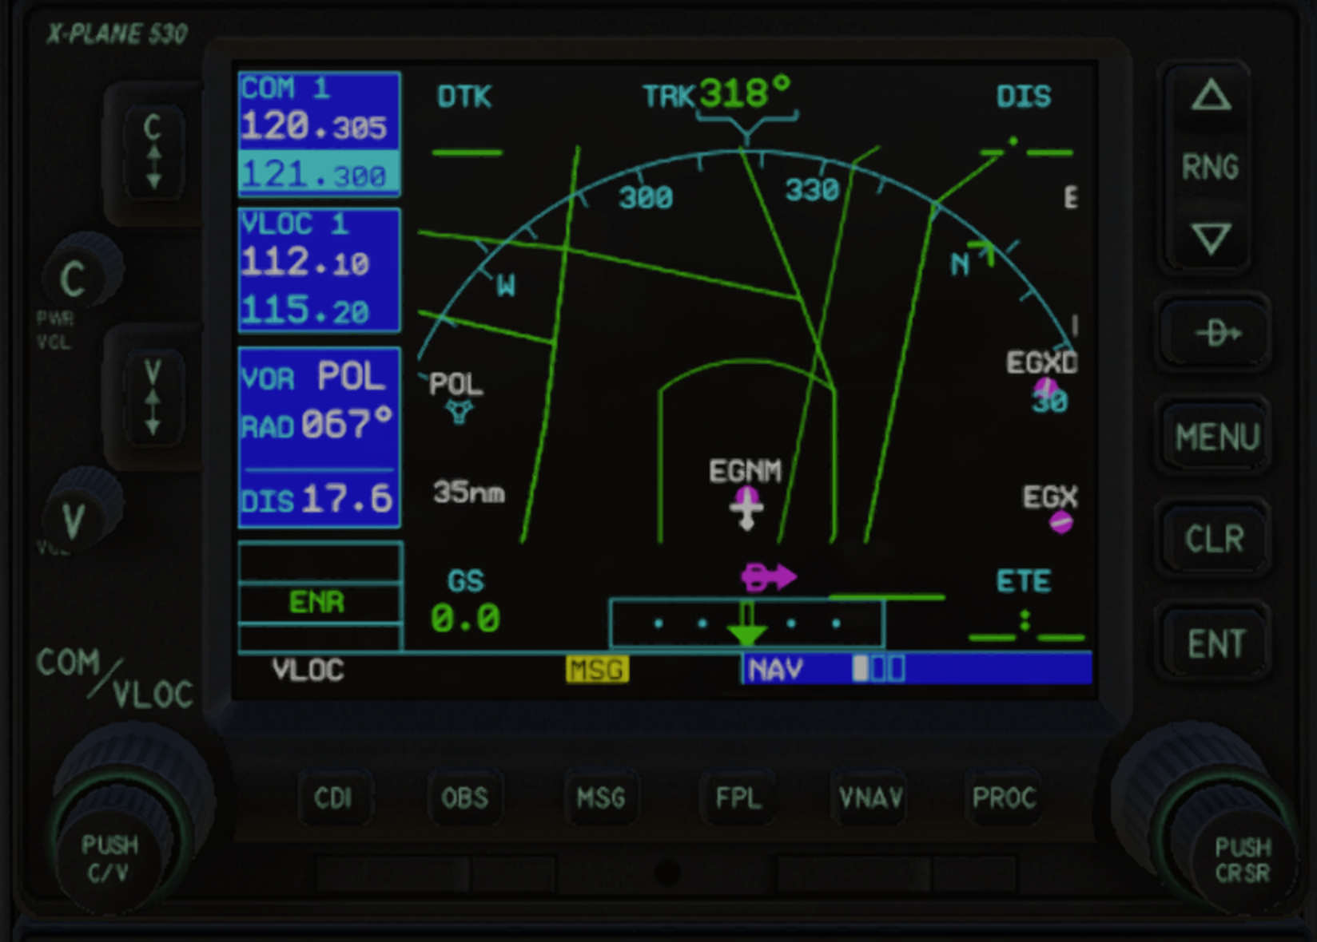
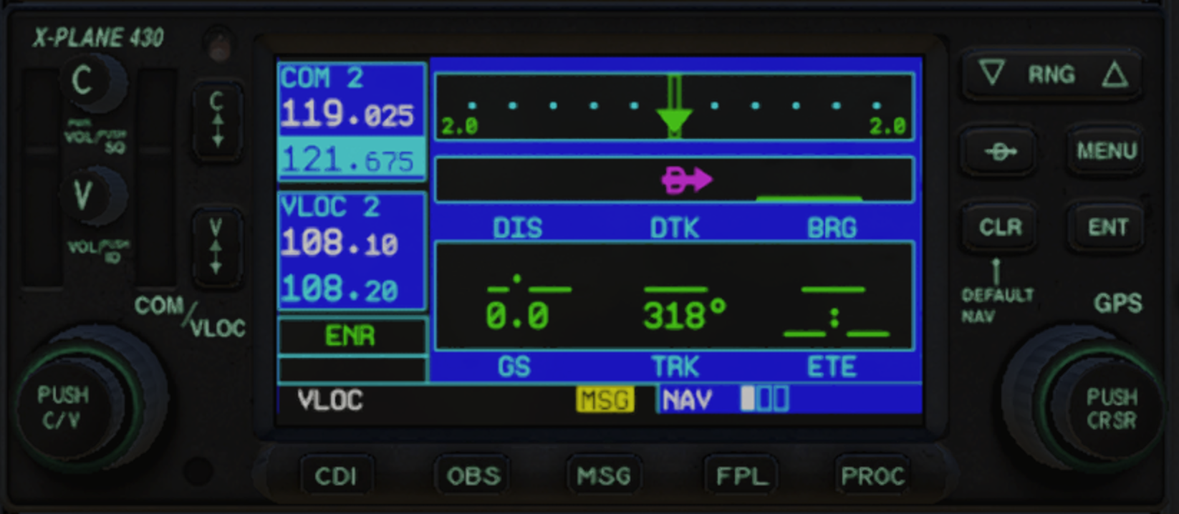
Controlling Garmin 430/530 (aligned configuration)
By configuring an aligned set of commands for the rotary controls and the autopilot buttons, it is possible to adjust most features of
the G430/G530 flight management devices directly from the Bravo control. (See also a later section on G1000 which follows a similar approach)
The bravo controls are mapped to the flight management device controls. The Toggles select different flight management functions and/or different
Flight management devices where an aircraft has more than one.
The example below is an extract from the default Laminar Cessna Skyhawk configuration, which has a G530
and a G430. Moving the rotary selector between CRS and IAS switches the Gx30 between fine control and
coarse control*.
When using aligned configurations like this, only one toggle should be active. Unexpected behavior may occur if
multiple toggles are active.
HoneycombOnArm64MacOS
Device | Toggle | Rotary CRS | Rotary IAS | Button HDG | Button NAV | Button APR | Button REV | Button ALT | Button VS | Button IAS | Button AP
G530 | Toggle 6 | COM/VLOC Coarse up/down | COM/VLOC Fine Up/down | COM-VLOC toggle | VLOC flip active | COM flip active
 | Toggle 5 | FPL chapter up/down | FPL page up/down | CDI | FPL | PROC | Direct | MENU | CLR | CURSOR | ENT
G430 | Toggle 4 | COM/VLOC Coarse up/down | COM/VLOC Fine Up/down | COM-VLOC toggle | VLOC flip active | COM flip active
 | Toggle 3 | FPL chapter up/down | FPL page up/down | CDI | FPL | PROC | Direct | MENU | CLR | CURSOR | ENT
© Dr Steve Proctor 2024
swp336@gmail.com
*See the Aircraft default configuration guide for more information on how to use this
User Guide vBeta1.02

Slide 12
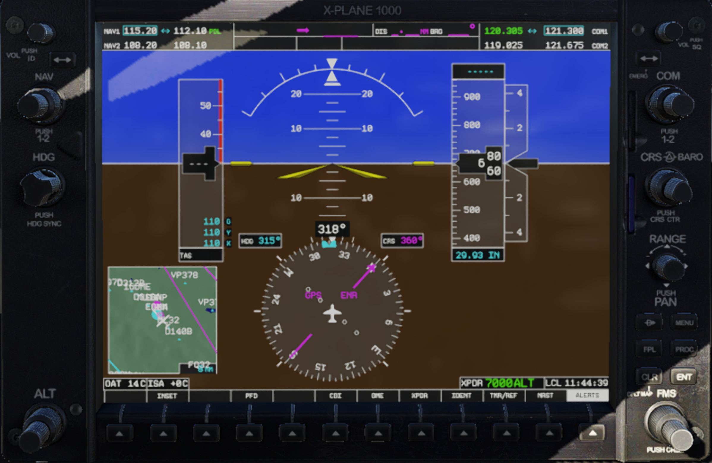
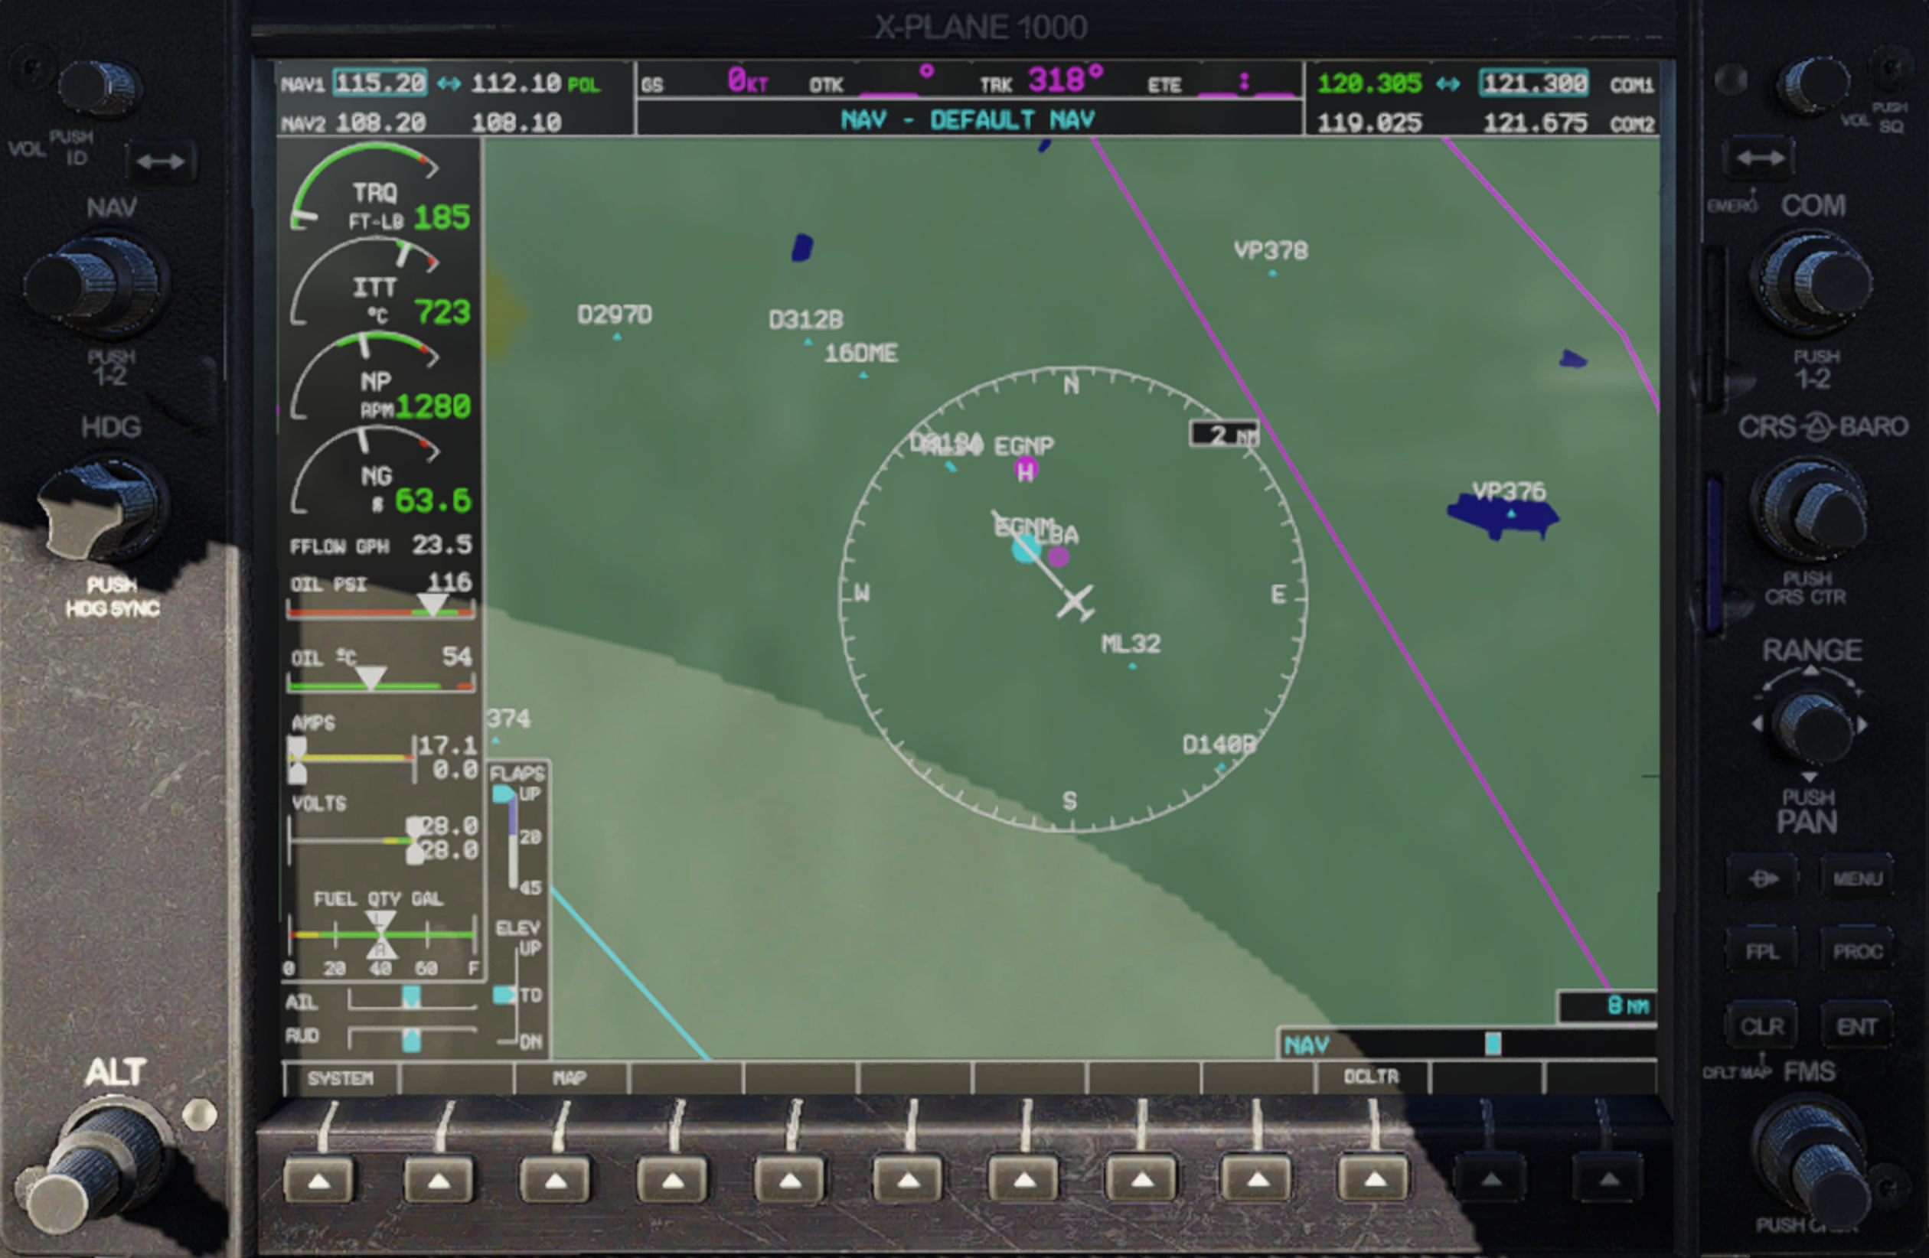
Controlling Garmin G1000 (aligned configuration)
The example below is an extract from the default Laminar Lancair evolution configuration, which has two G1000 devices
(PFD and MFD).
When using aligned configurations like this, only one toggle should be active. Unexpected behavior may occur if
multiple toggles are active.
Using the controls in this way may be a little confusing to start with, but quickly becomes second nature with use.
As far as possible, this same layout is used across all the default configurations, so familiarity gained via one aircraft
transfers to other aircraft with similar flight management devices.
HoneycombOnArm64MacOS
Device | Toggle | Rotary HDG | Rotary CRS | Rotary IAS | Button HDG | Button NAV | Button APR | Button REV | Button ALT | Button VS | Button IAS | Button AP
PFD | Toggle 6 | - | NAV Coarse up/down | NAV Fine Up/down | NAV 1-2 toggle | NAV flip active
 | Toggle 5 | - | COM Coarse up/down | COM Fine up/down | COM 1-2 toggle | COM flip active
MFD | Toggle 4 | Range Up/down | FMS Coarse up/down | FMS Fine Up/down | CDI | FPL | PROC | Direct | MENU | CLR | CURSOR | ENT
© Dr Steve Proctor 2024
swp336@gmail.com
User Guide vBeta1.02

Slide 13
Configuring annunciators and autopilot button LEDs
The plugin allows you to specify datarefs to control the lighting for the annunciator panel and for the autopilot buttons. These are configured in the json file.
The majority of the Laminar Research aircraft use a common set of annunciators, but some do add custom annunciators. Default configurations are provided for all the Laminar Research aircraft (see next 2 pages for details).
Note, not all aircraft support all annunciators. For example, some of the smaller aircraft do not have any hydraulic systems
or an APU.
To control a light the dataref must have value zero when inactive (light off) and be non-zero when active (light on).
You can attach multiple datarefs to a single annunciator or button, in which case the light is off when all its
associated datarefs are zero, or the light is on if any one of its datarefs is non-zero
The plugin supports integer, boolean and float datarefs, plus arrays.
HoneycombOnArm64MacOS
© Dr Steve Proctor 2024
swp336@gmail.com
User Guide vBeta1.02

Slide 14
Default annunciator datarefs
HoneycombOnArm64MacOS
Annunciator | Dataref
Master Warning | sim/cockpit2/annunciators/master_warning
Engine Fire | sim/cockpit/warnings/annunciators/engine_fire
Low Oil Pressure | sim/cockpit/warnings/annunciators/oil_pressure
Low Fuel Pressure | sim/cockpit/warnings/annunciators/fuel_pressure
Anti Ice | sim/cockpit/warnings/annunciators/ice
Starter Engaged | sim/cockpit2/engine/actuators/starter_hit
APU | sim/cockpit/engine/APU_running
Master Caution | sim/cockpit/warnings/annunciators/master_caution
Vacuum | sim/cockpit/warnings/annunciators/low_vacuum
Low Hyd Pressure | sim/cockpit2/annunciators/hydraulic_pressure
Aux Fuel Pump | sim/cockpit2/fuel/showing_aux
Parking Brake | sim/cockpit2/controls/parking_brake_ratio
Low Volts | sim/cockpit/warnings/annunciators/low_voltage
Door Light | sim/cockpit/warnings/annunciators/cabin_door_open
© Dr Steve Proctor 2024
swp336@gmail.com
User Guide vBeta1.02

Slide 15
Default autopilot button datarefs
HoneycombOnArm64MacOS
Button LED | Dataref
HDG | sim/cockpit2/autopilot/heading_status
NAV | sim/cockpit2/autopilot/nav_status
APR | sim/cockpit2/autopilot/approach_status
REV | sim/cockpit2/autopilot/backcourse_status
ALT | sim/cockpit2/autopilot/altitude_hold_status
VS | sim/cockpit2/autopilot/vvi_status
IAS | sim/cockpit2/autopilot/speed_status
AP | sim/cockpit2/autopilot/servos_on
© Dr Steve Proctor 2024
swp336@gmail.com
User Guide vBeta1.02

Slide 16
Modifying default configurations
The json files can be edited to change the default commands. The only thing that cannot change is the filename, which is tied to the specific aircraft.
If you modify a json file, but later decide to revert back to the default, you can simply delete (or rename) the modified file. The plug-in will create a new default json file next time you fly that aircraft.
A full list of supported aircraft and their default configurations can be found
in the Aircraft Default Configurations Guide.
HoneycombOnArm64MacOS
© Dr Steve Proctor 2024
swp336@gmail.com
User Guide vBeta1.02

Slide 17
HoneycombOnArm64MacOS
Configuring unsupported aircraft
If you fly an aircraft the plugin doesn’t know, it will create a basic default configuration. This will have the correct filename for the aircraft and a best guess at likely commands and datarefs. Depending on your aircraft, this basic default may have only partial functionality or possibly no functionality at all.
You then have two options:
Edit the default json file to the configuration you require, or
Copy an existing configuration that’s closer to your requirements and rename it to the correct
filename for the aircraft. Starting from a similar aircraft may be easier to edit than starting from the
basic default
Note: using the DataRefTool plugin is a great way to interactively discover the commands and datarefs used by your
aircraft. It proved invaluable when developing the default configs for the supported aircraft.
You can find it at https://datareftool.com
Instructions for editing the json file are beyond the scope of this guide. Hopefully a lot of the format is clear if you
study the default files.
Note, the first release of the HoneycombForMac plugin has limited error detection when reading json files. It is
tolerant of typos in command names and dataref names (they are interpreted as ‘no action’), but syntax errors may
crash the plugin.
© Dr Steve Proctor 2024
swp336@gmail.com
User Guide vBeta1.02

Slide 18
HoneycombOnArm64MacOS
End of User Guide
© Dr Steve Proctor 2024
swp336@gmail.com
User Guide vBeta1.02

